Slide 1
Team 3
Analysing Yelp Dataset using Spark and Comparative Study with
different distributed processes
Visnunathan Chidambaranathan - 40230157
Revanth Velagandula - 40229629
SanVinoth Pacham- 40198906
Sharanyu Pillai - 40227794

Slide 2
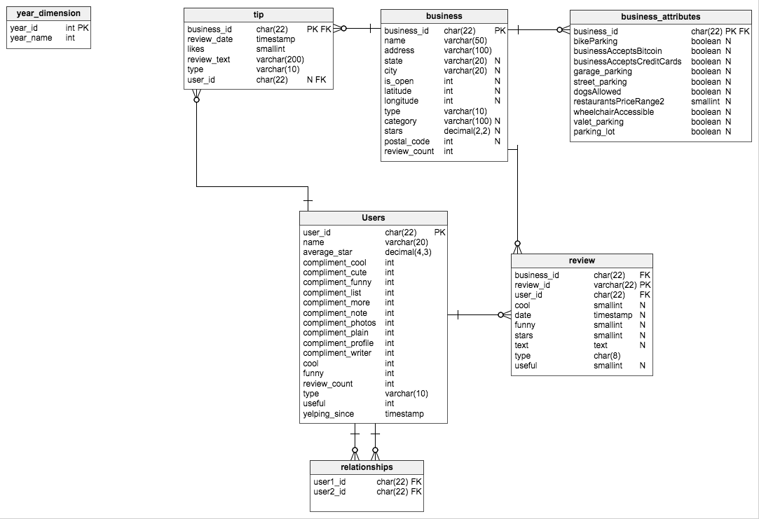
Dataset - ( ~9 GB )
https://www.kaggle.com/datasets/yelp-dataset/yelp-dataset
Yelp Dataset for Business reviews
Tables used :
Yelp_academic_dataset_business.json
Yelp_academic_dataset_checkin.json
Yelp_academic_dataset_review.json
Yelp_academic_dataset_tip.json
Yelp_academic_dataset_user.json
After Data PreProcessing we have
reduced the size to 2 GB

Slide 3
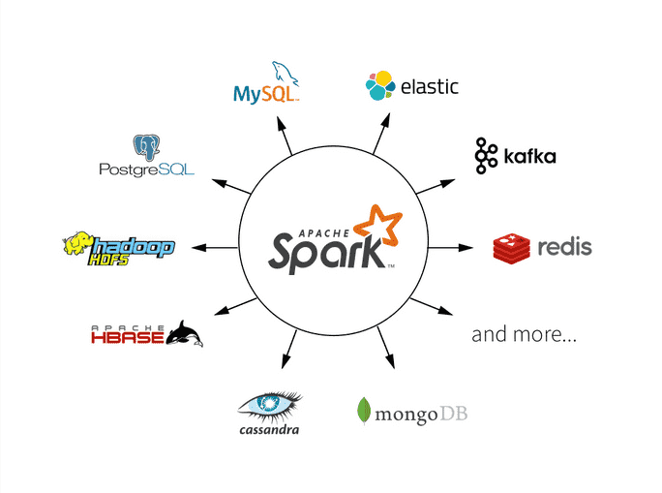
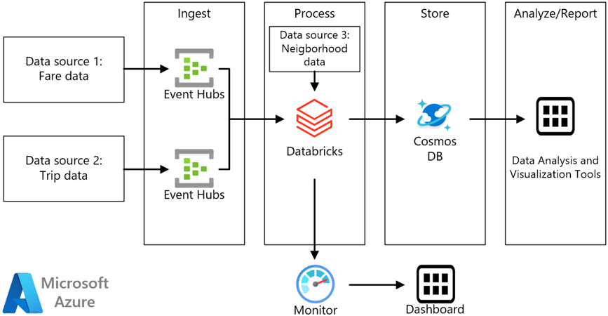
Why SPARK?
Distributed
In-memory processing
Multi Language support
Flexibility
Scalability
Why Databricks?
Scalability
Collaboration
Integration
Performance
Security

Slide 4
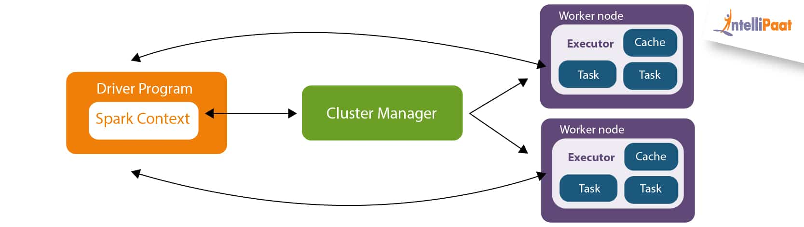
Apache spark architecture

Slide 5









Architecture Diagram
Mounting Blob Containers using SAS token
Cluster
Connection
Staging
Fetching Records through the running cluster
Blob
Delta tables on top of Parquet files
Tableau Data Query
Query Analysis Dashboard

Slide 6
Spark Features Implementation
1. Persistence
2. Lazy evaluation
3. Fault tolerance
4. Data Partitioning
5. Parallelism
6. Transparency

Slide 7
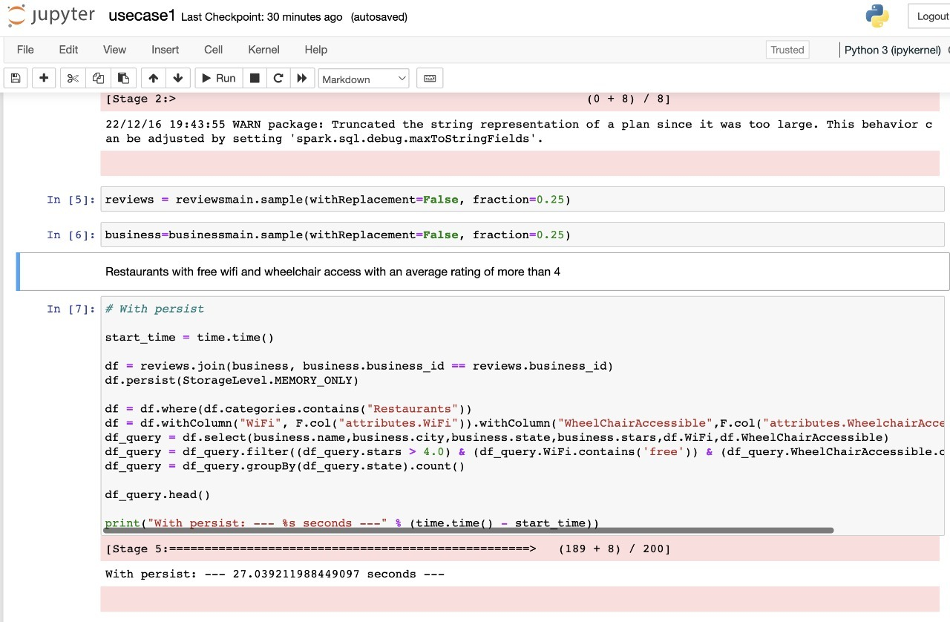
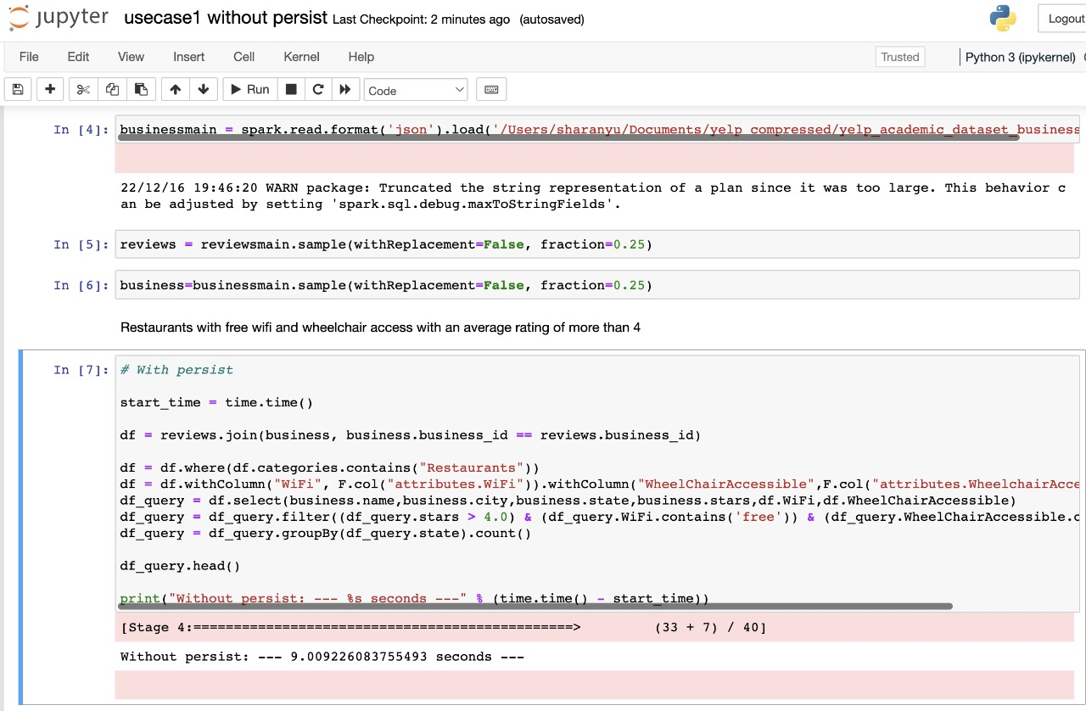
Persistence
With persistence
Without Persistence

Slide 8
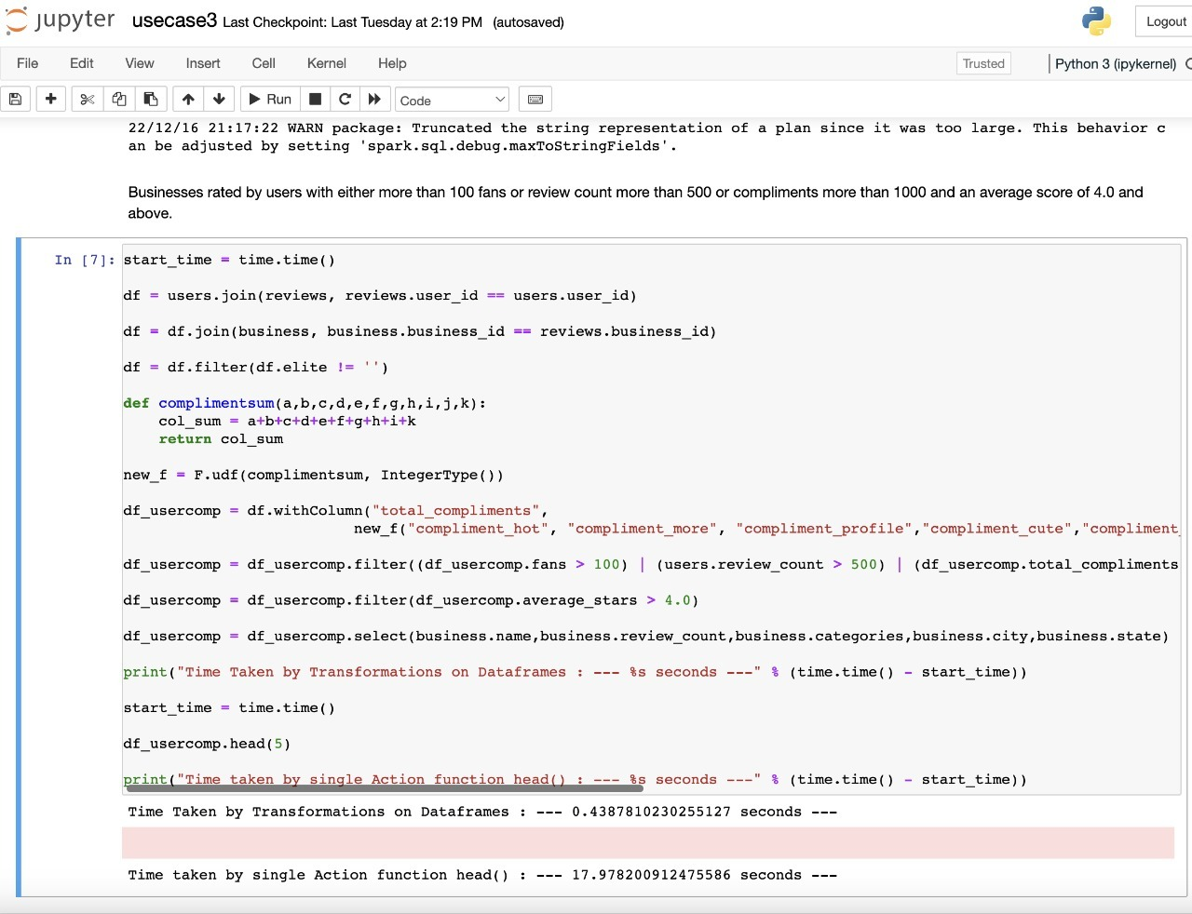
Lazy Evaluation

Slide 9
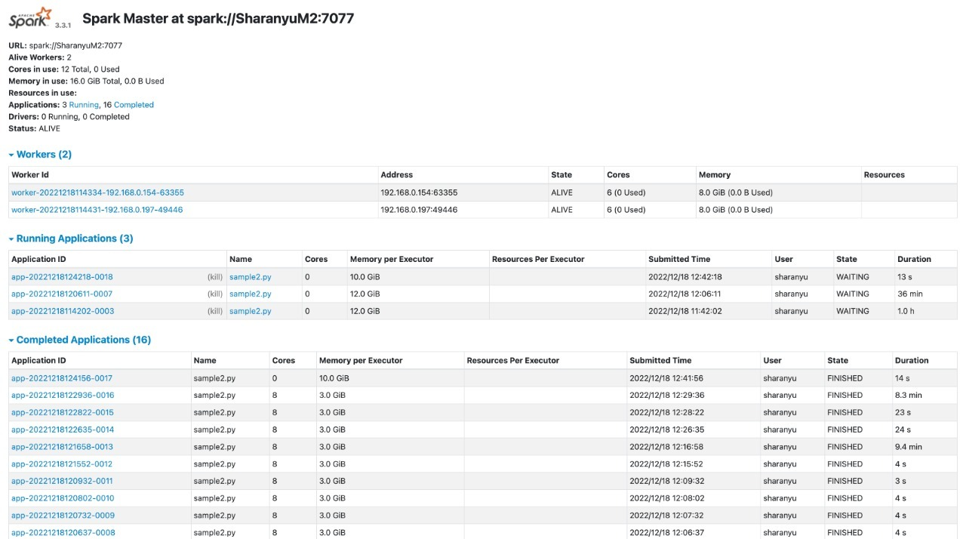
Implementation of a Distributed System to execute Spark Using Multiple Computers
Master - (192.168.0.117)

Slide 10
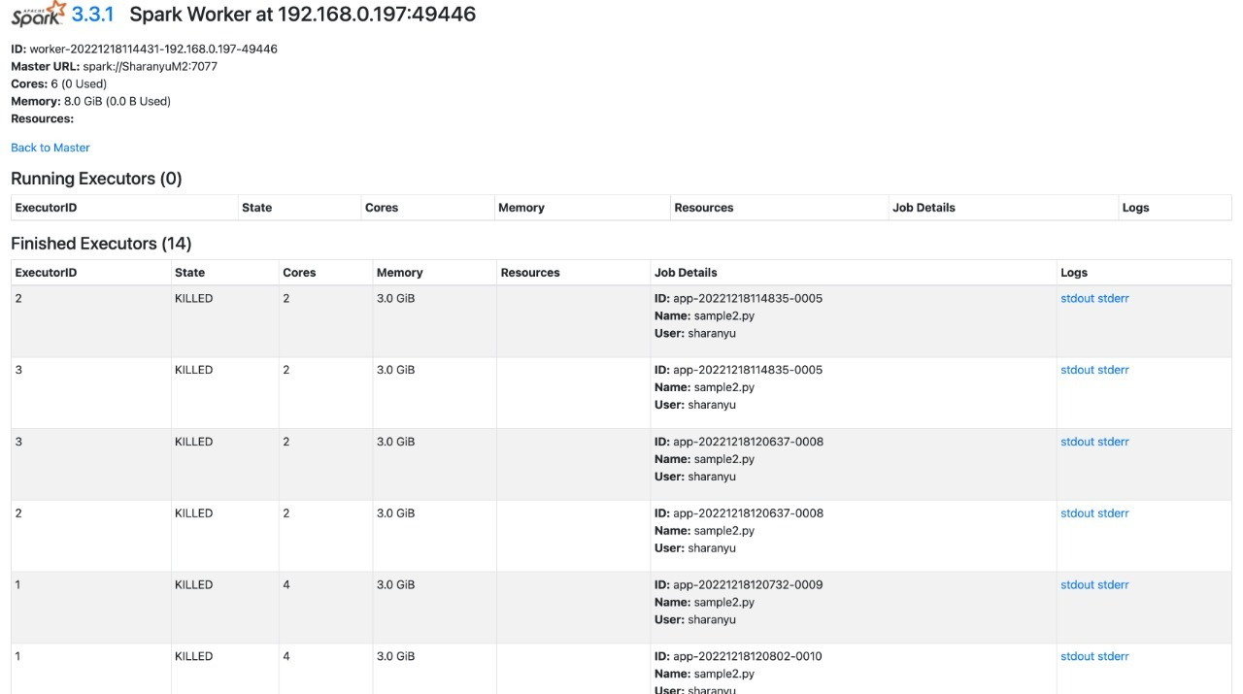

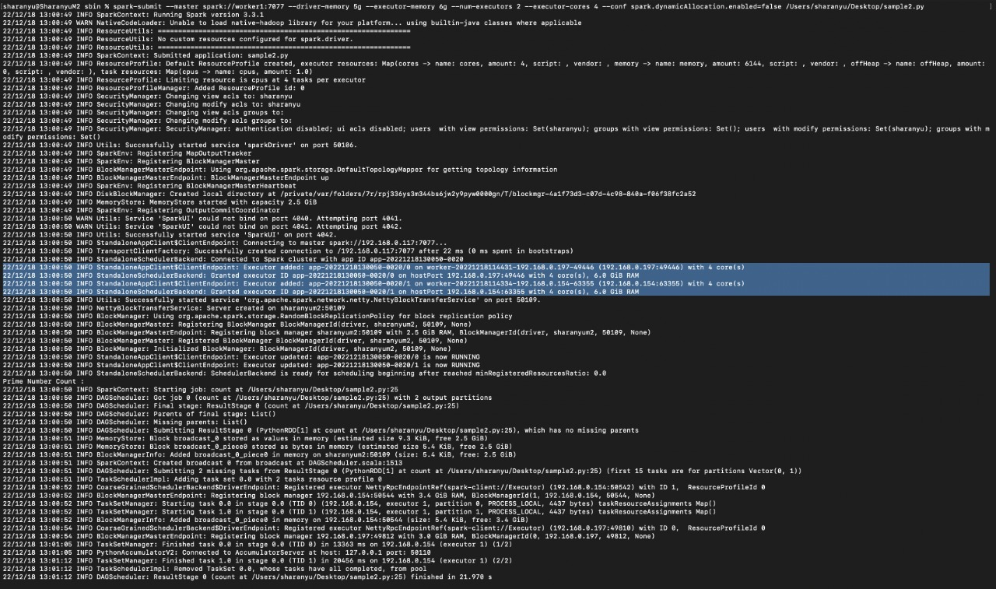
Worker 1 - (192.168.0.197)
Worker 2 - (192.168.0.197)
Implementation

Slide 11
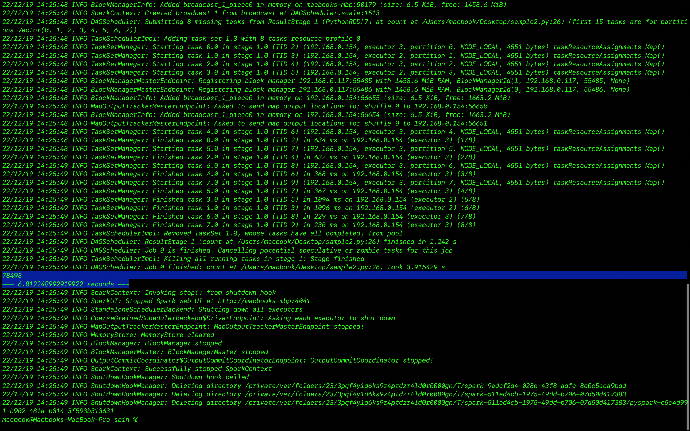

Slide 12
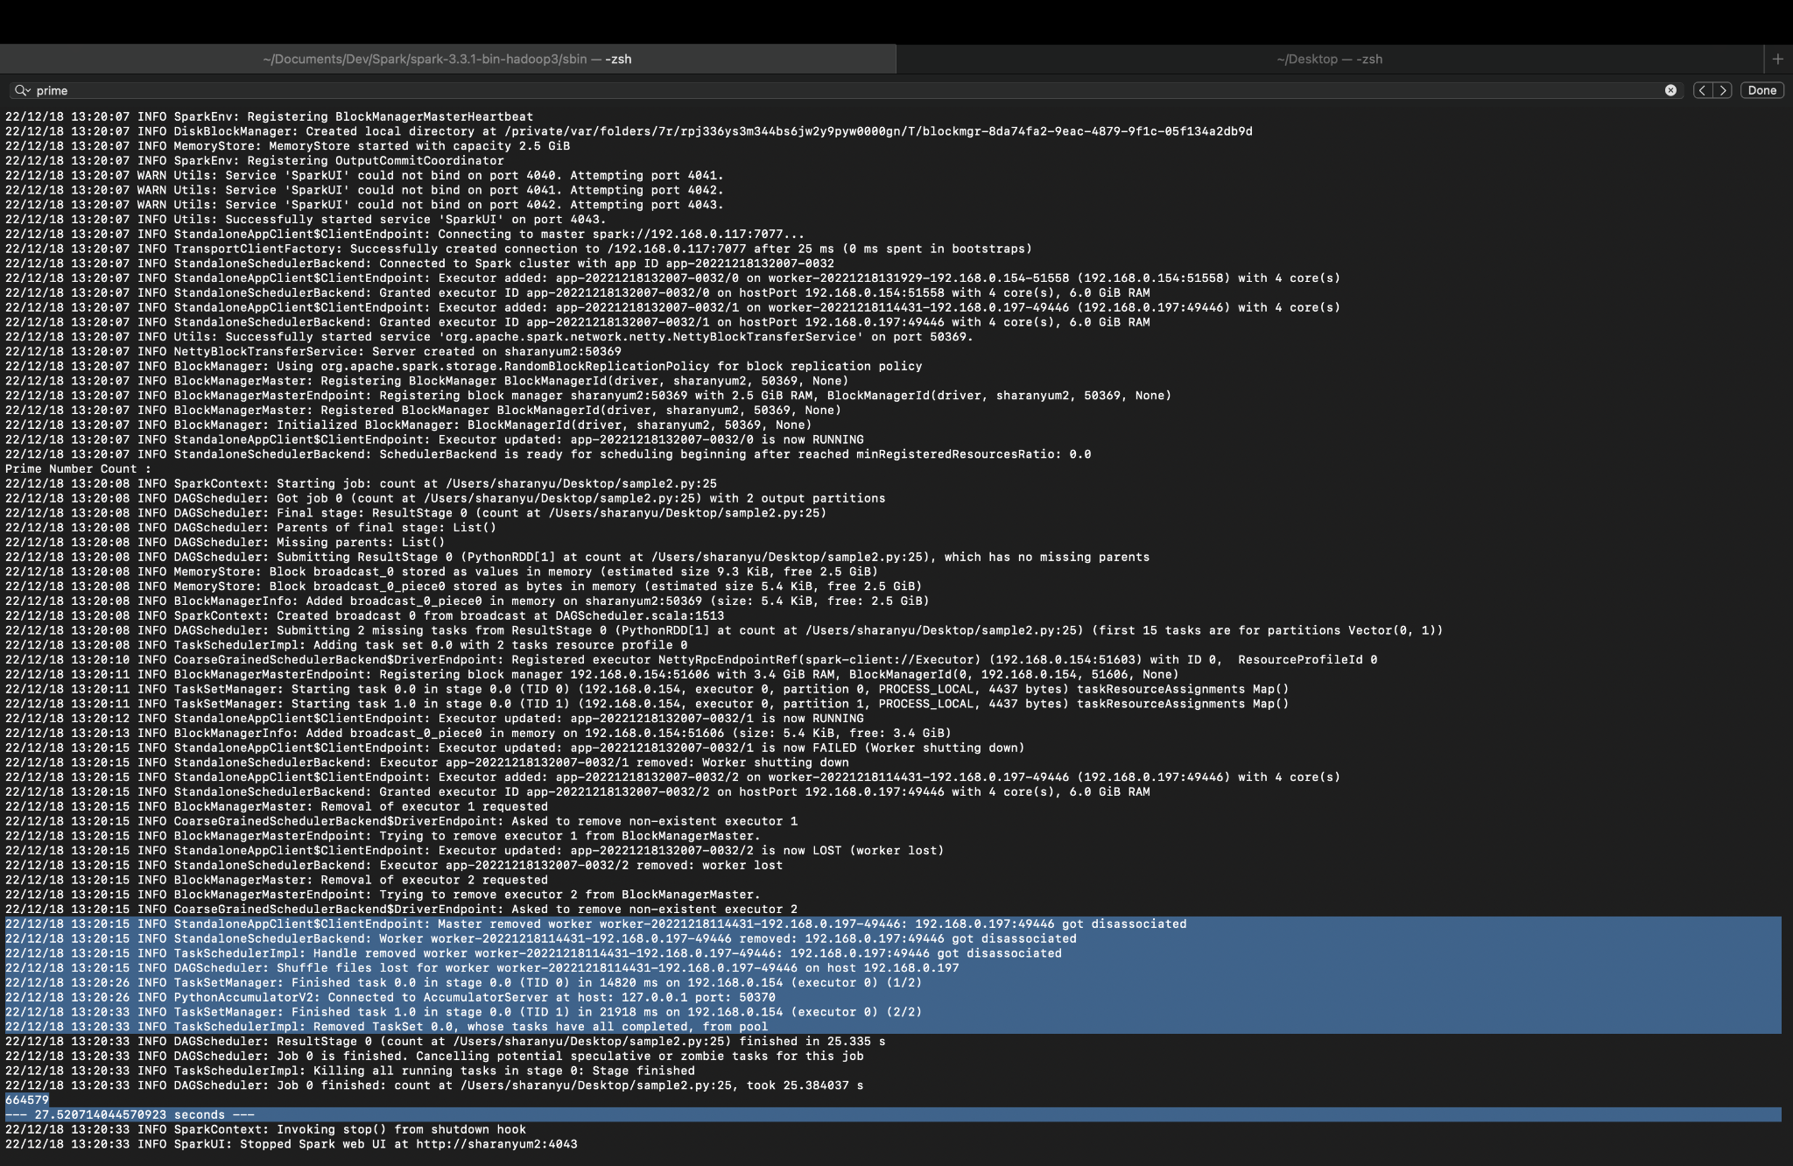
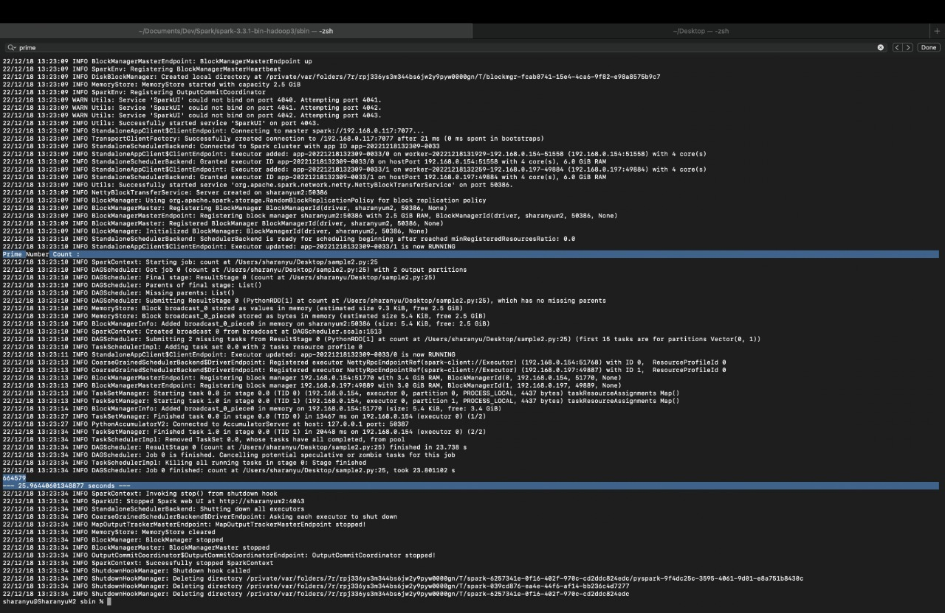
Fault tolerance
With 1 worker node failing - (27.52 sec)
With 2 worker nodes- (25.96 sec)

Slide 13
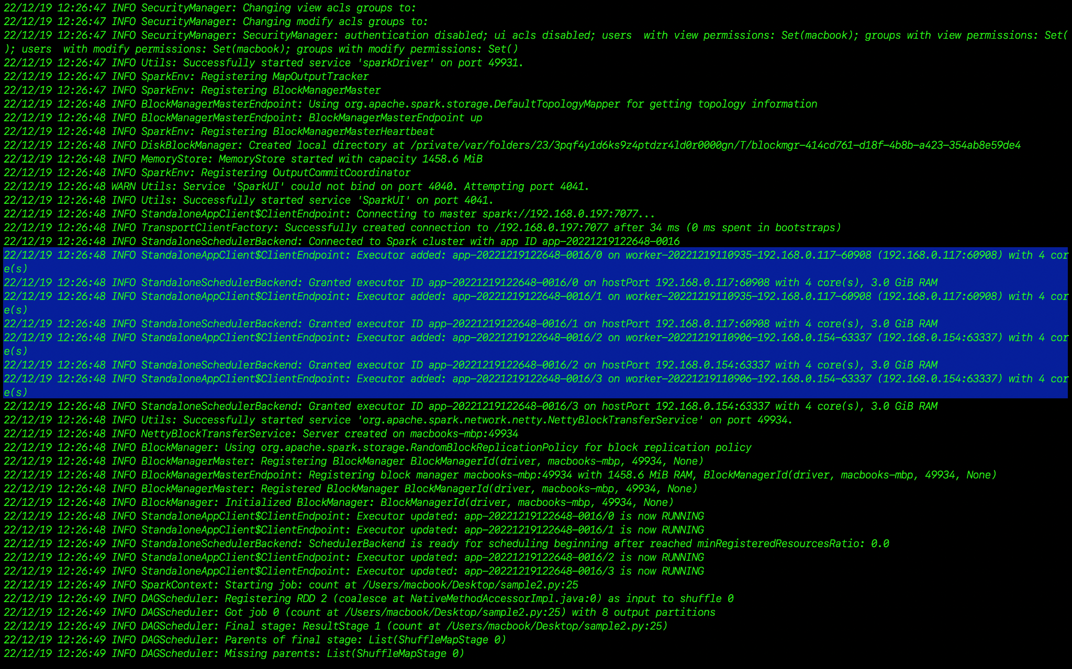
Parallelism

Slide 14
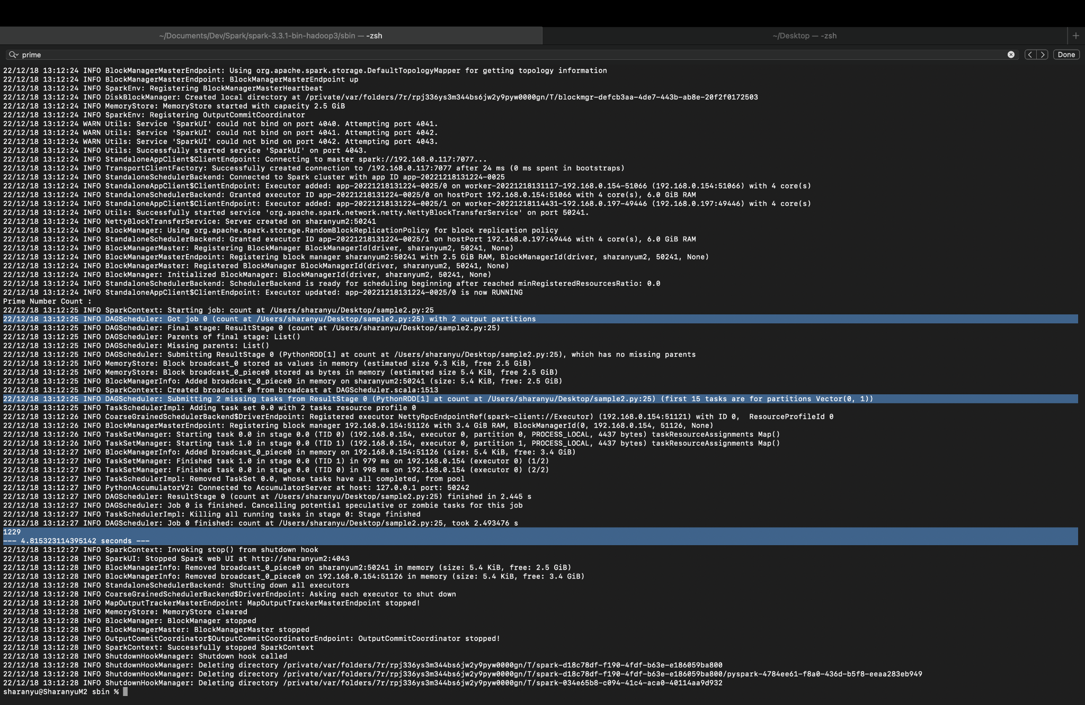
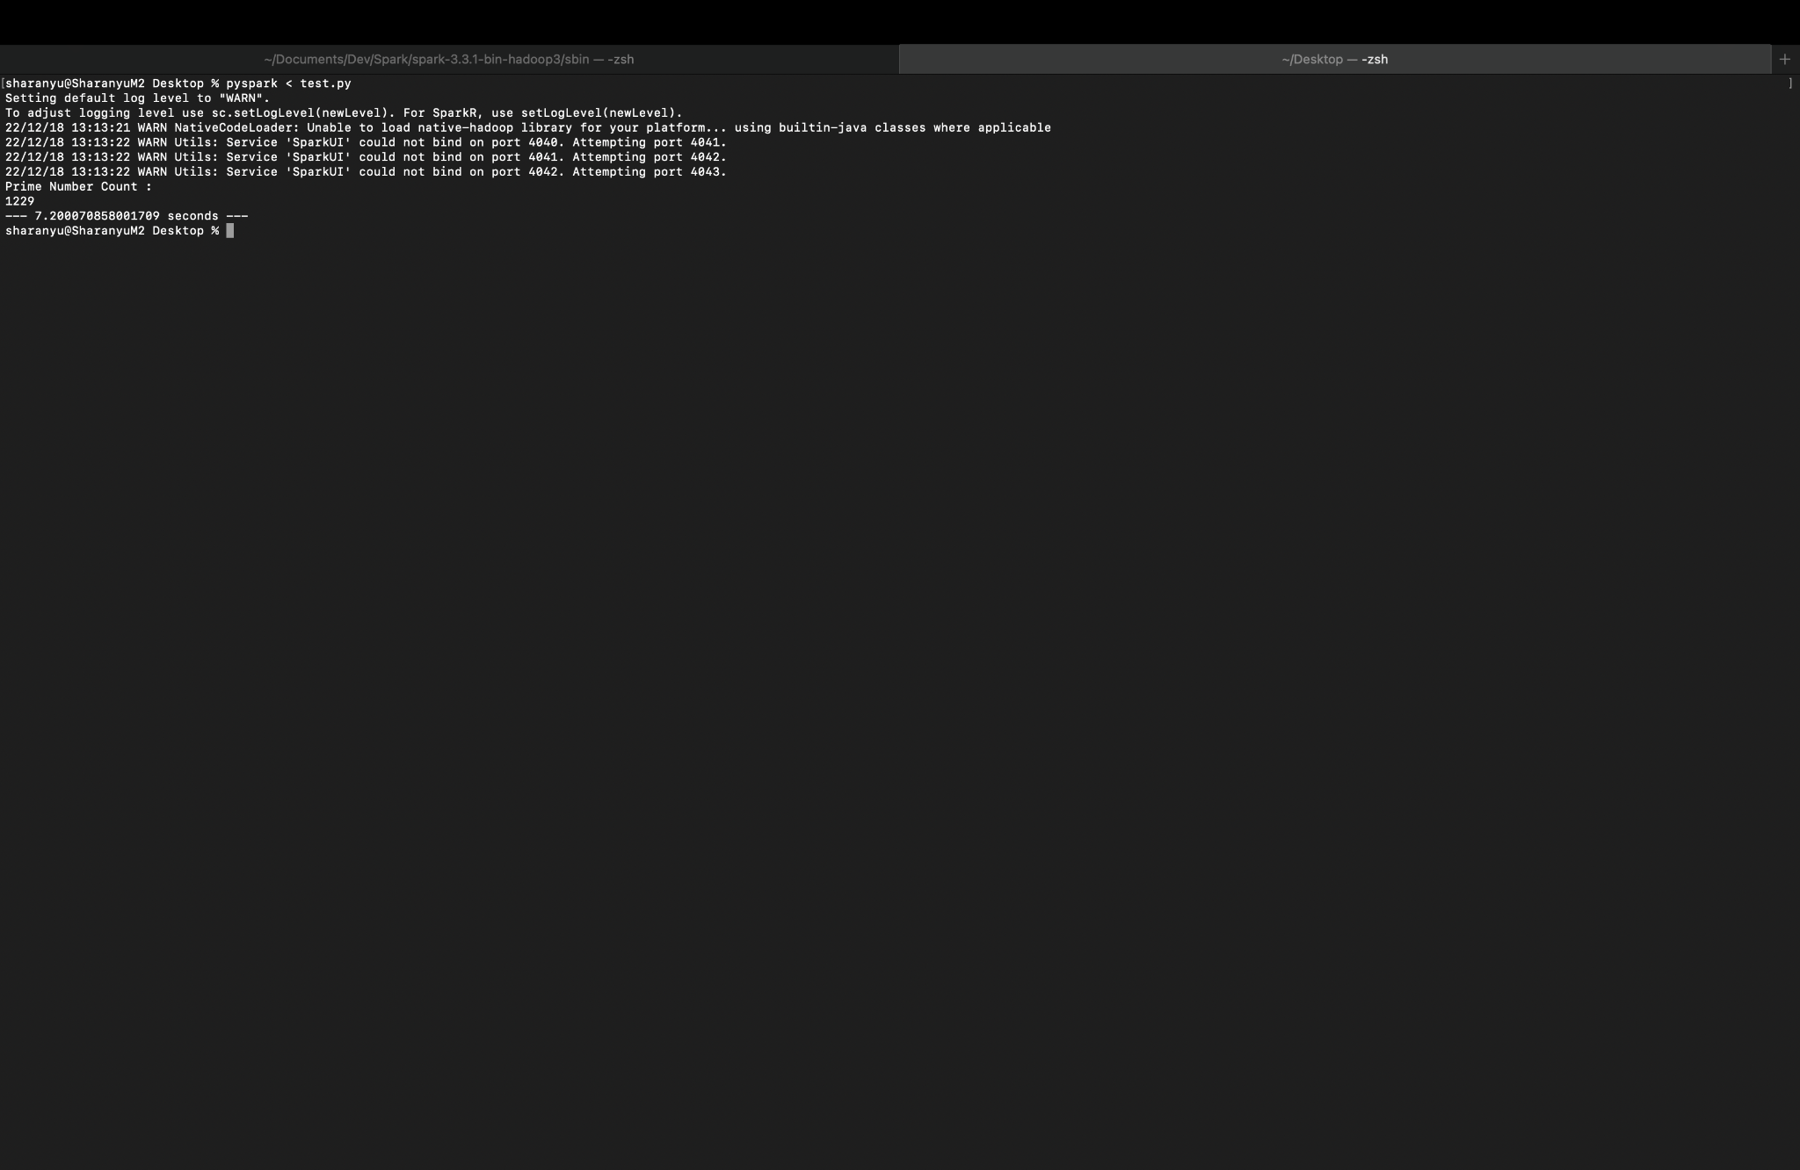
With Parallelism- (4.81 sec)
Without Parallelism- (7.2 sec)

Slide 15
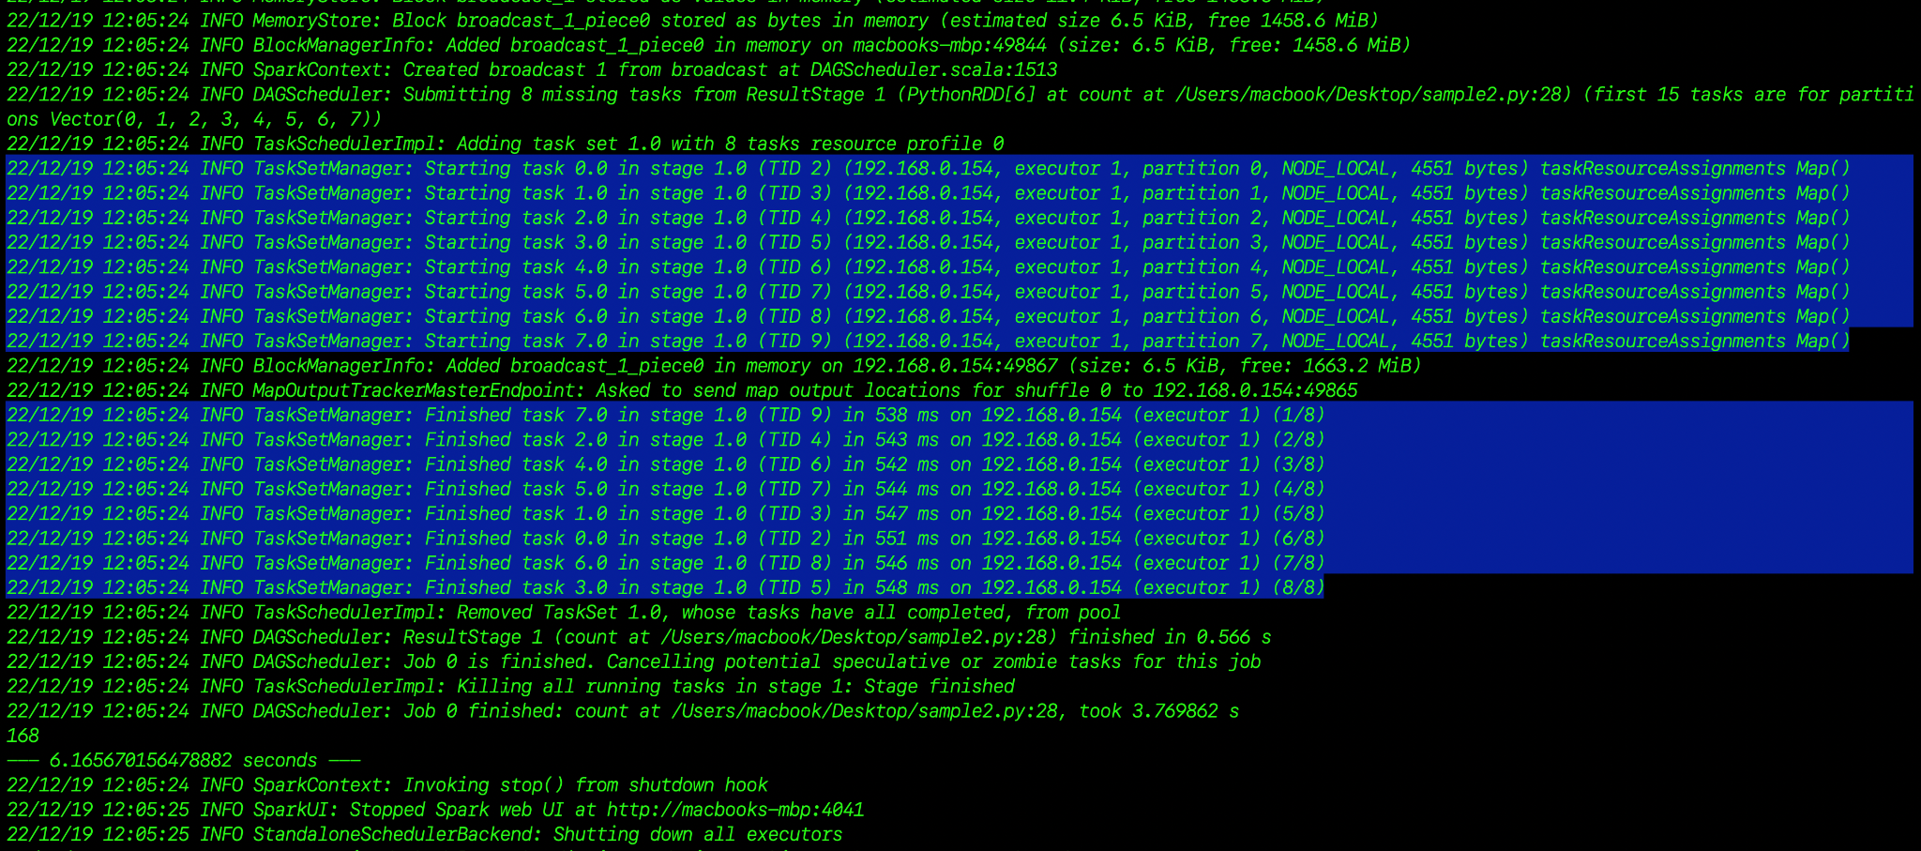
Data Partitioning
DD.z

Slide 16
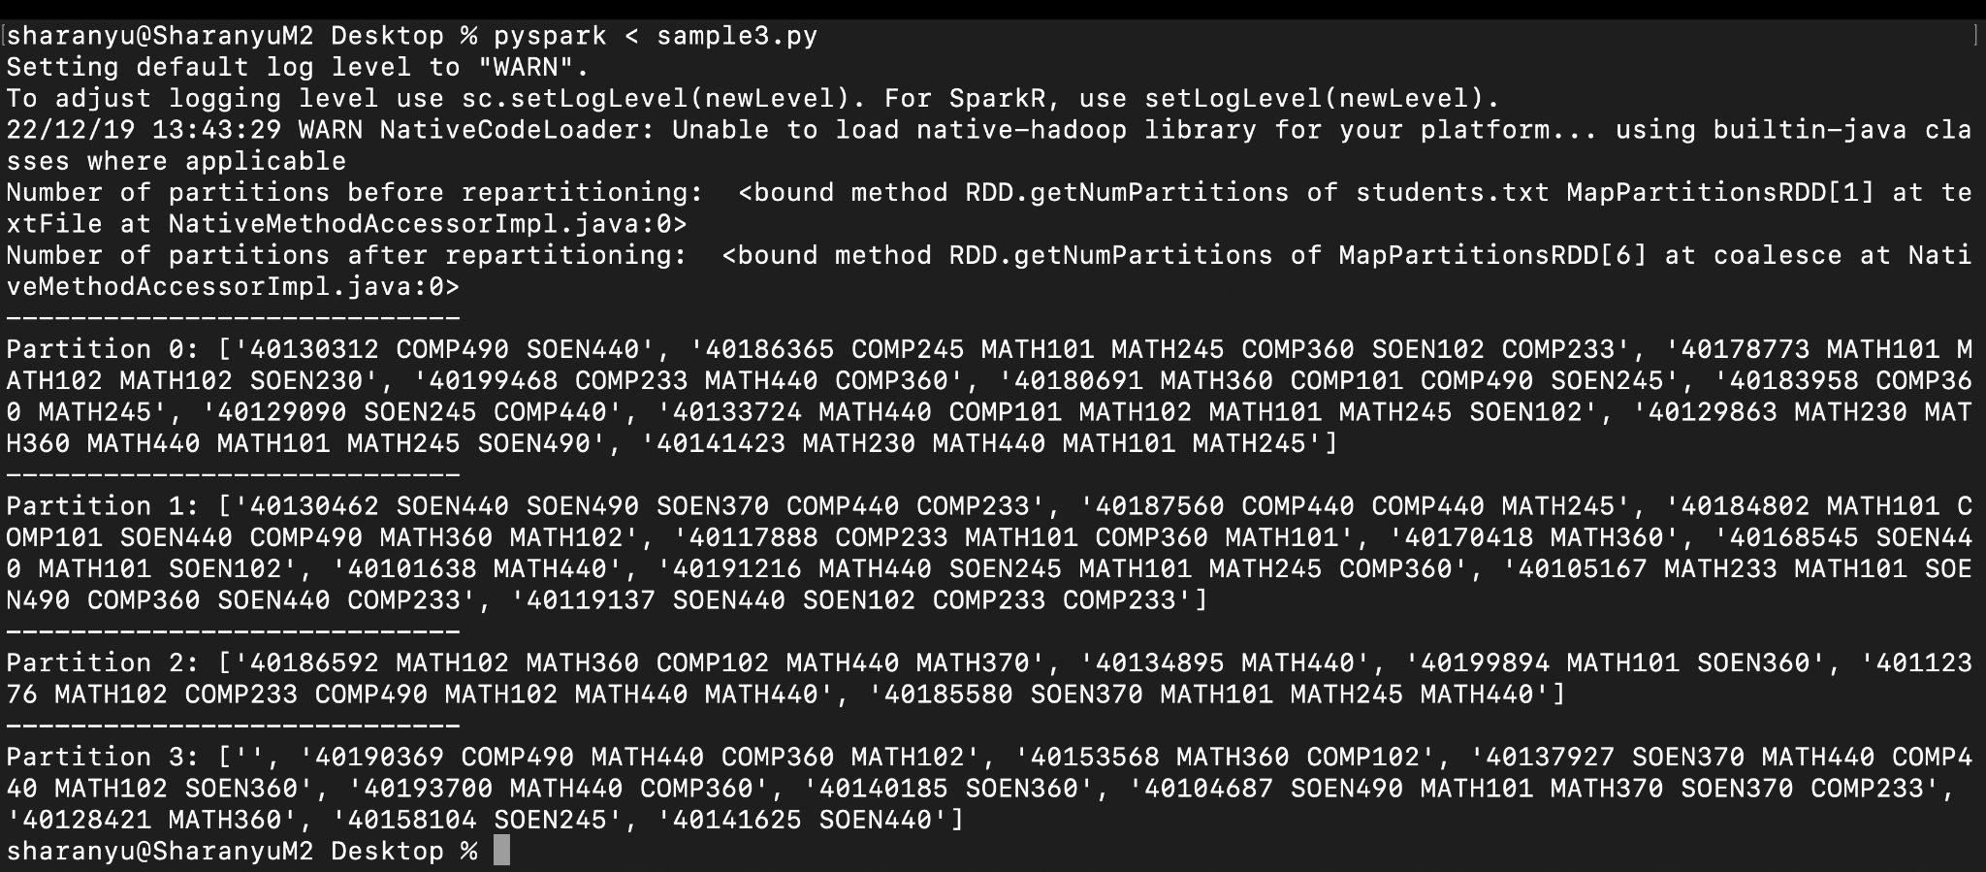
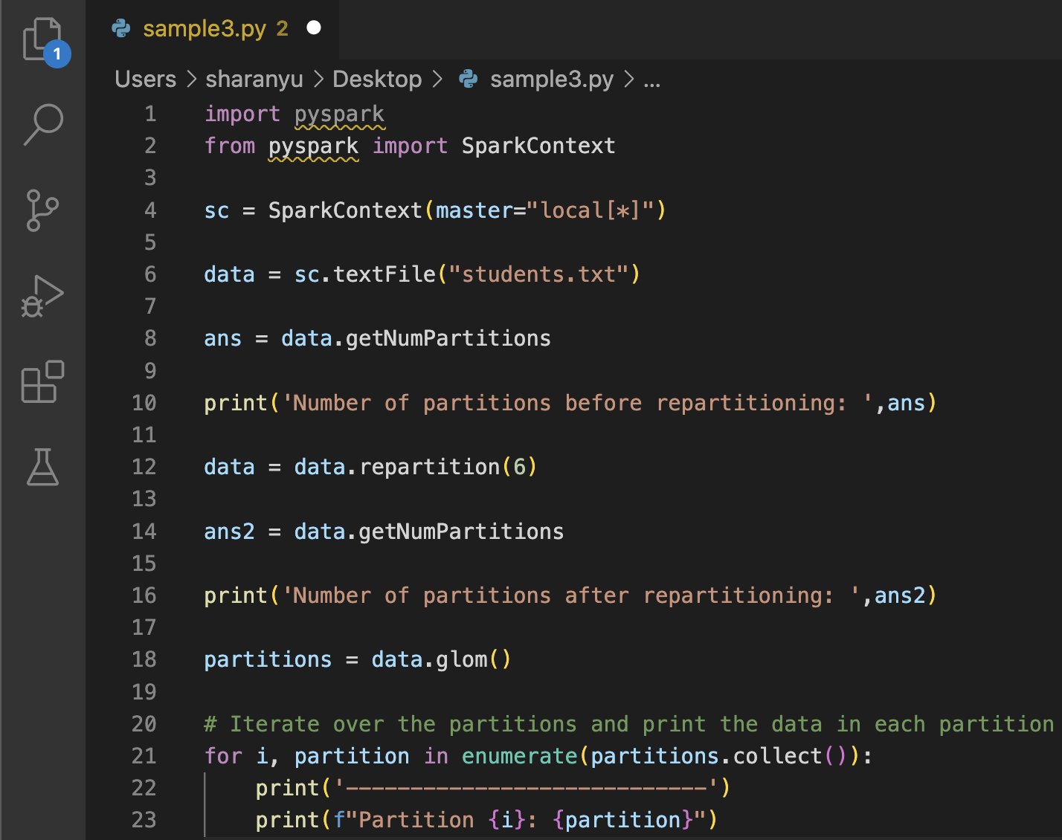

Slide 17
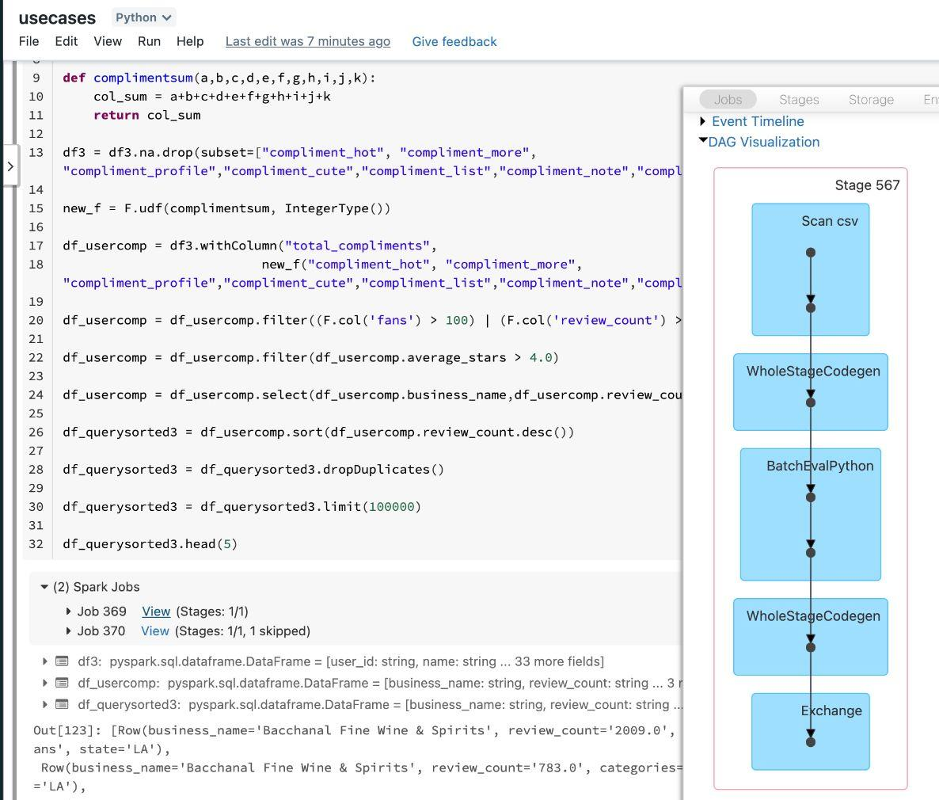
Transparency - Data Lineage

Slide 18
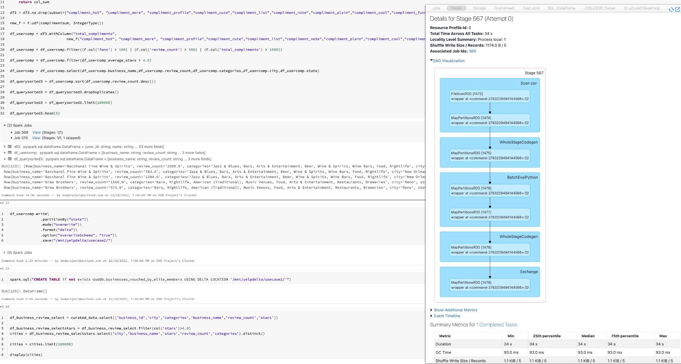

Slide 19
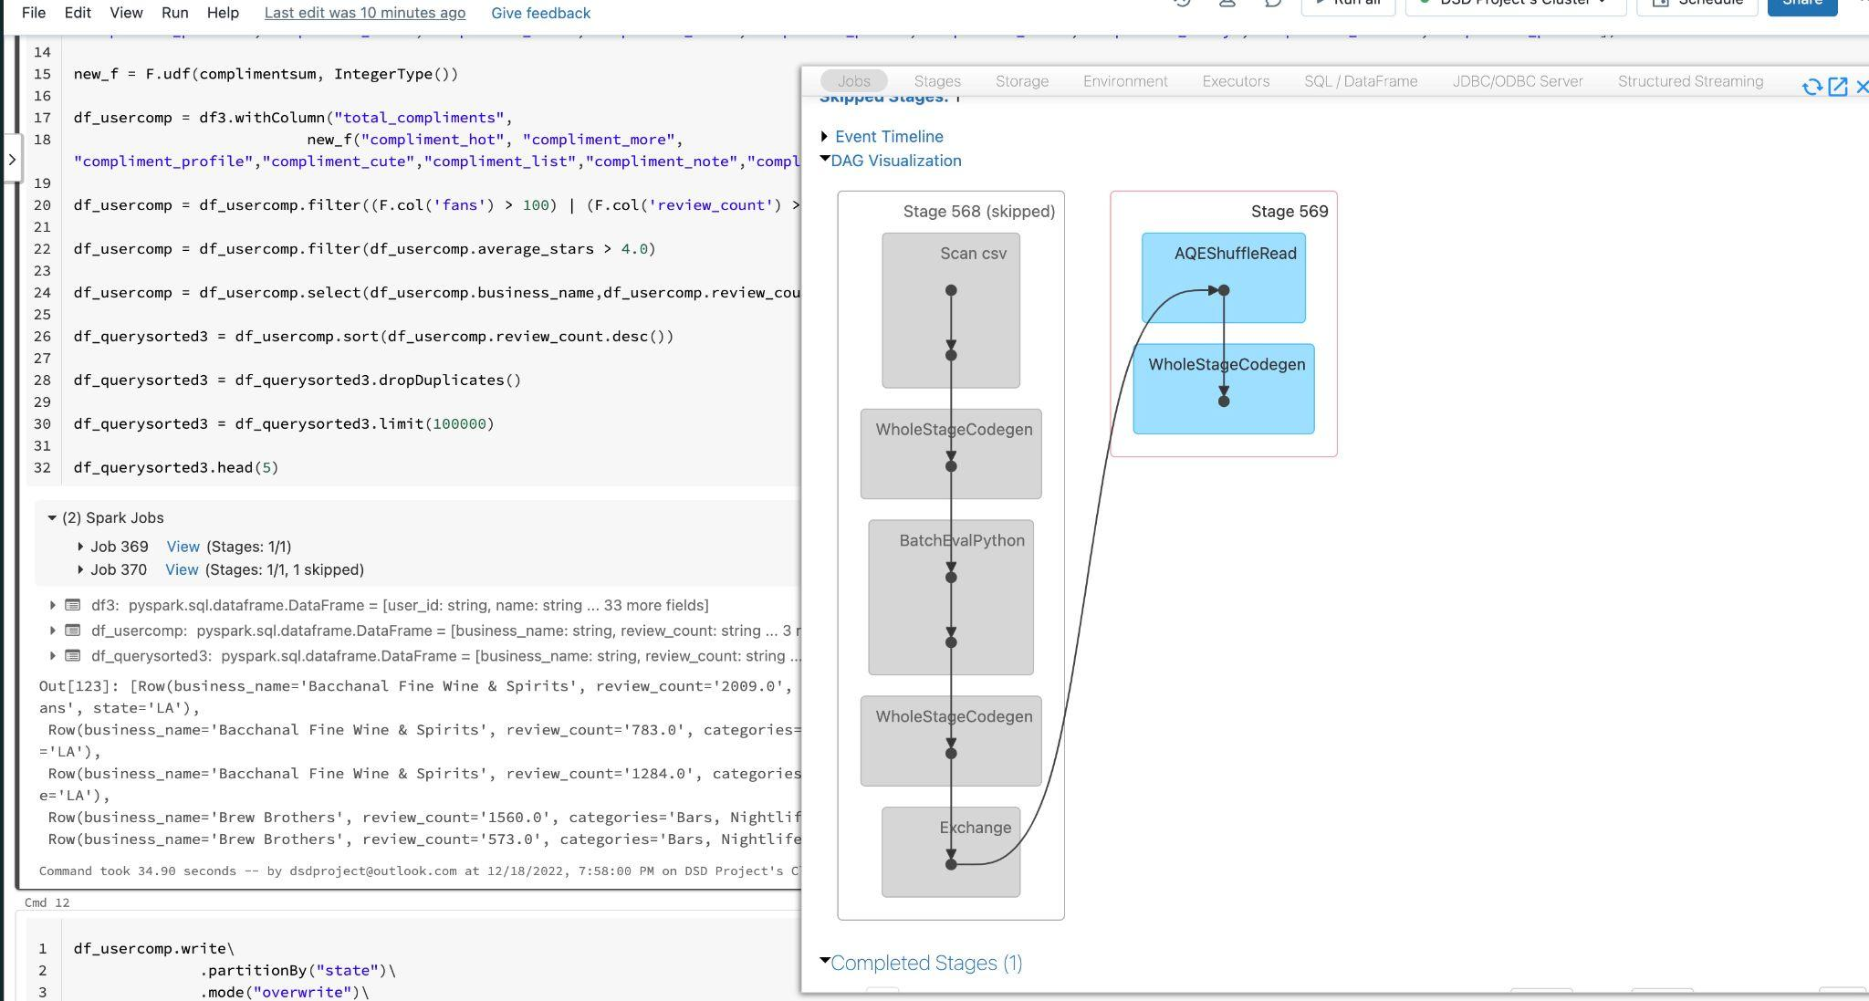

Slide 20
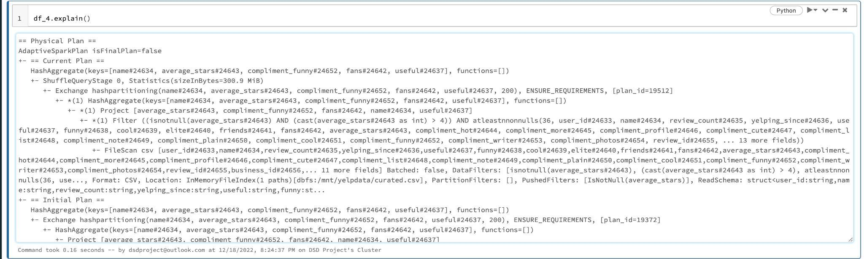
Ensuring transparency in Spark data processing with the explain() method

Slide 21
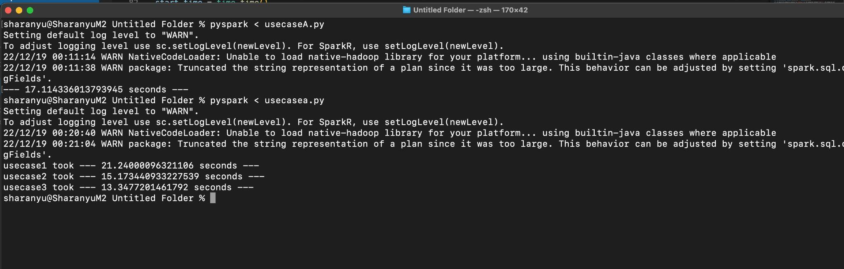
9GB file pyspark execution for the usecase in local system(8 Core MacOs)

Slide 22

Yelp Dataset Analysis & Comparative Analysis of Distributed Programming Techniques
https://public.tableau.com/app/profile/san.vinoth/viz/YelpDatasetComparativeAnalysis/YelpAnalysis?publish=yes

Slide 23
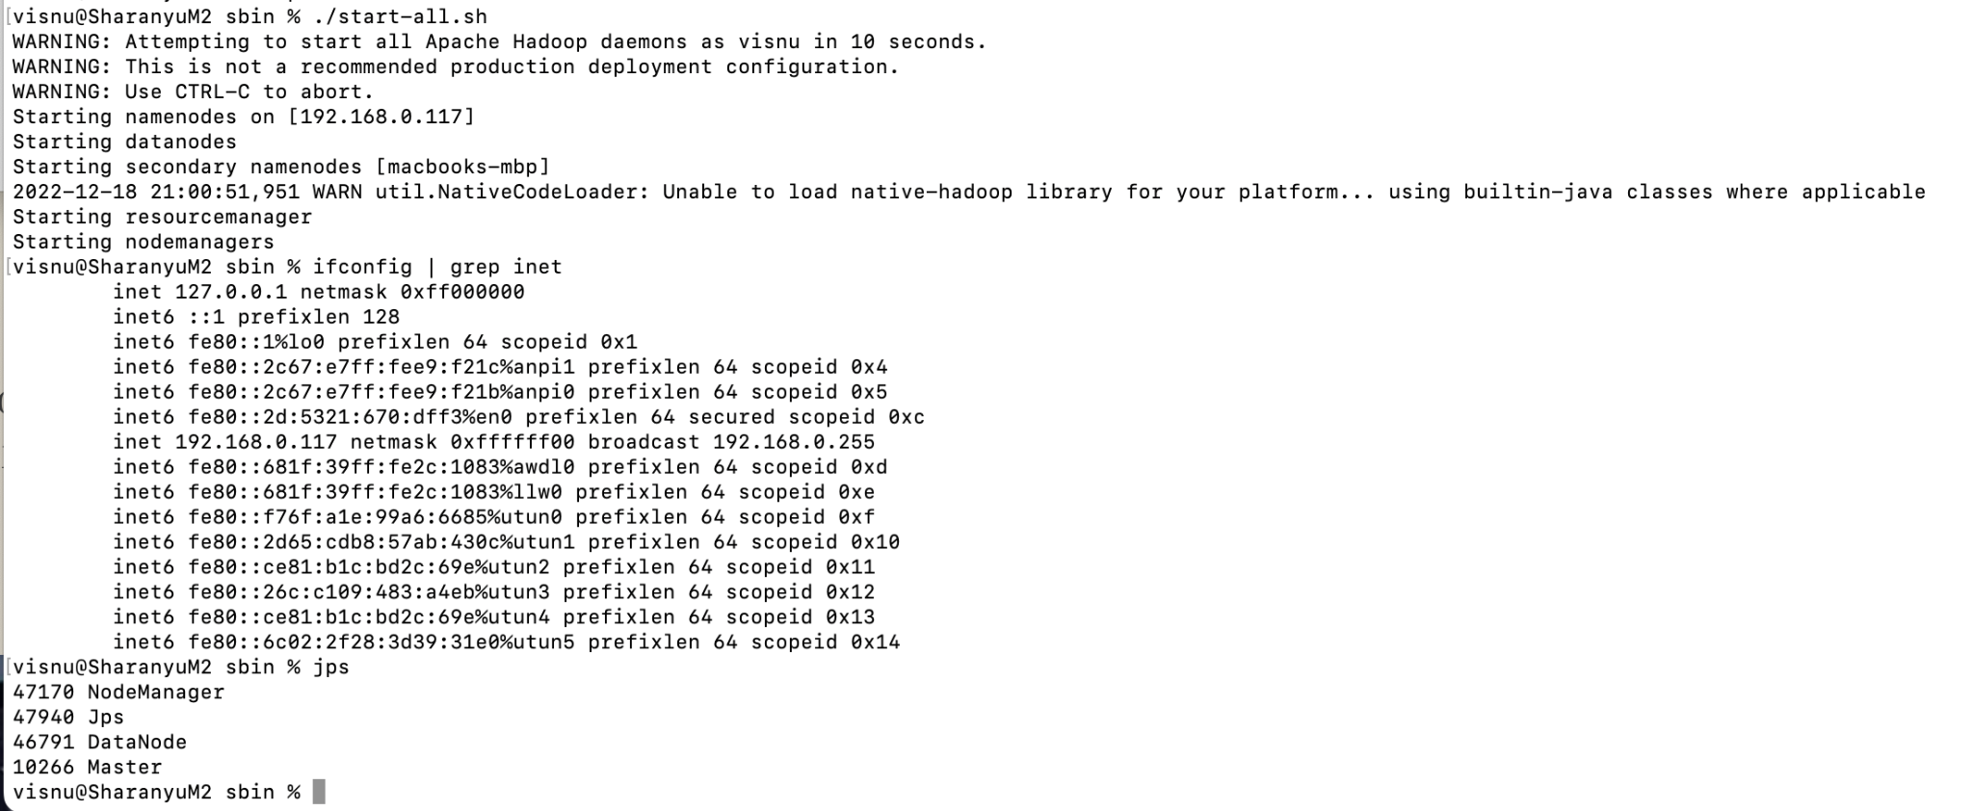
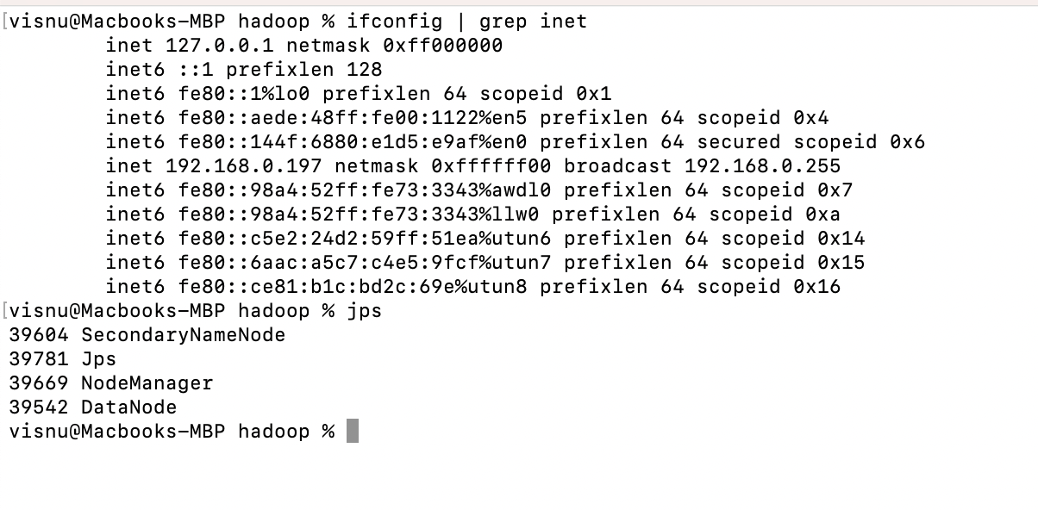
Additional Works - (Hadoop Cluster)
Master Node
Worker Node

Slide 24
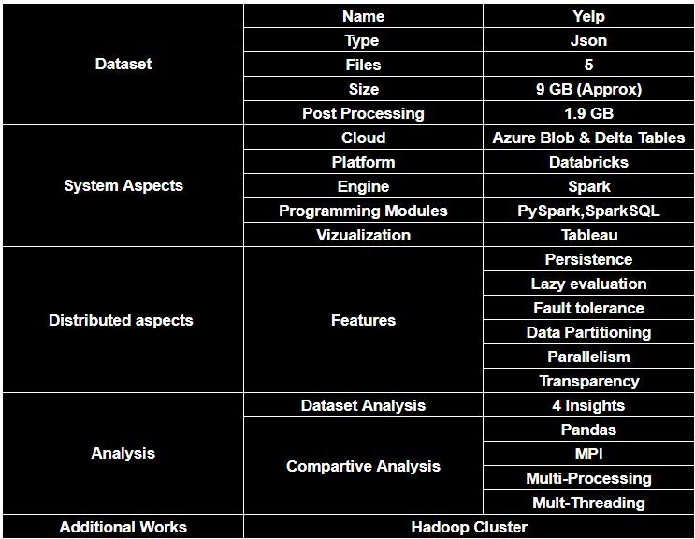
Project Components:

Slide 25
Learning
Spark
Databricks
Azure Blob
Tableau
Setting up standalone clusters
Hadoop environment setup
Team Work

